Slide 1
TELCO CUSTOMER CHURN ANALYSIS
Trần Đức Anh
PL300-95
Date : 28/12/2023

Slide 2
About Dataset
The data set includes information about:
Customers who left within the last month – the column is called Churn
Services that each customer has signed up for – phone, multiple lines, internet, online security, online backup, device protection, tech support, and streaming TV and movies
Customer account information – how long they’ve been a customer, contract, payment method, paperless billing, monthly charges, and total charges
Demographic info about customers – gender, age range, and if they have partners and dependents

Slide 3
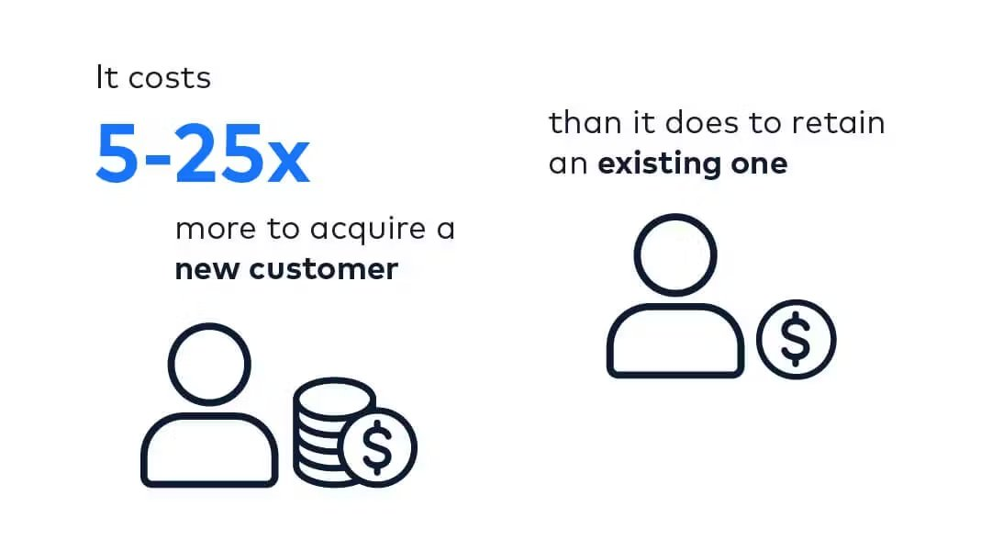
Why Is Analyzing Customer Churn Important?
• Revenue and profit impact
- Customer churn directly affects a company's revenue. Losing customers means losing their associated revenue streams
• Cost of Acquisition

Slide 4
Objectives
• Identifying Churn Patterns
- Analyzing historical data to identify patterns and trends associated with customer churn.
• Providing Actionable Recommendations
- Offer actionable recommendations for reducing churn based on the analysis

Slide 5
01
02
Table of contents
03
04
Introduction
Customer Overview
Churn Analysis
Proposed Solution

Slide 6
01
Introduction

Slide 7
Company Overview
Telco is a provider of telecommunication services, which provides a variety of services such as phone services and internet services
Internet Services
Phone Services
Additional Services
DSL
Fiber optic
Streaming
Multiple Lines
Online Backup
Online Security
Device
Protection
Tech Support
TV
Movie

Slide 8
02
Customer Overview

Slide 9
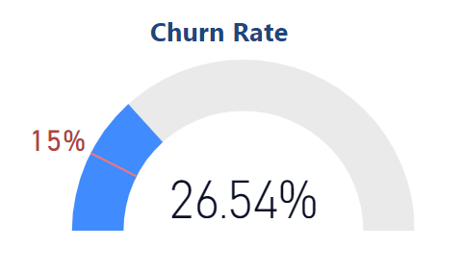
Customer Overview
7043
Total Customers
1869
Total Churned Customers
26.54%
Churn Rate
16.06M
Total Revenue
- The customer churn rate exceeds the permissible threshold of 10%
Target churn rate

Slide 10
03
Churn Analysis

Slide 11
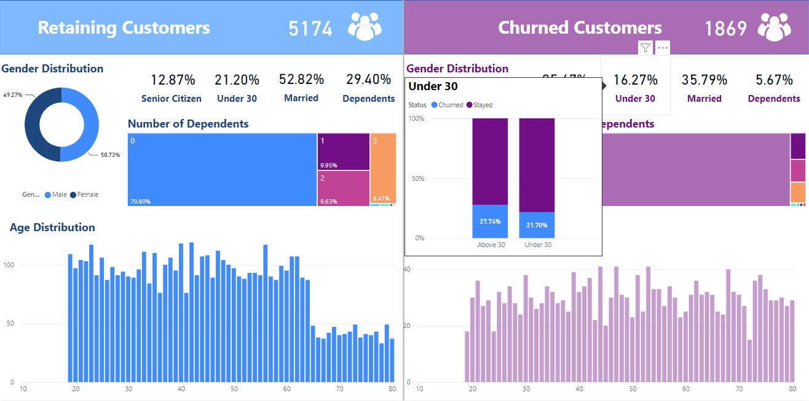
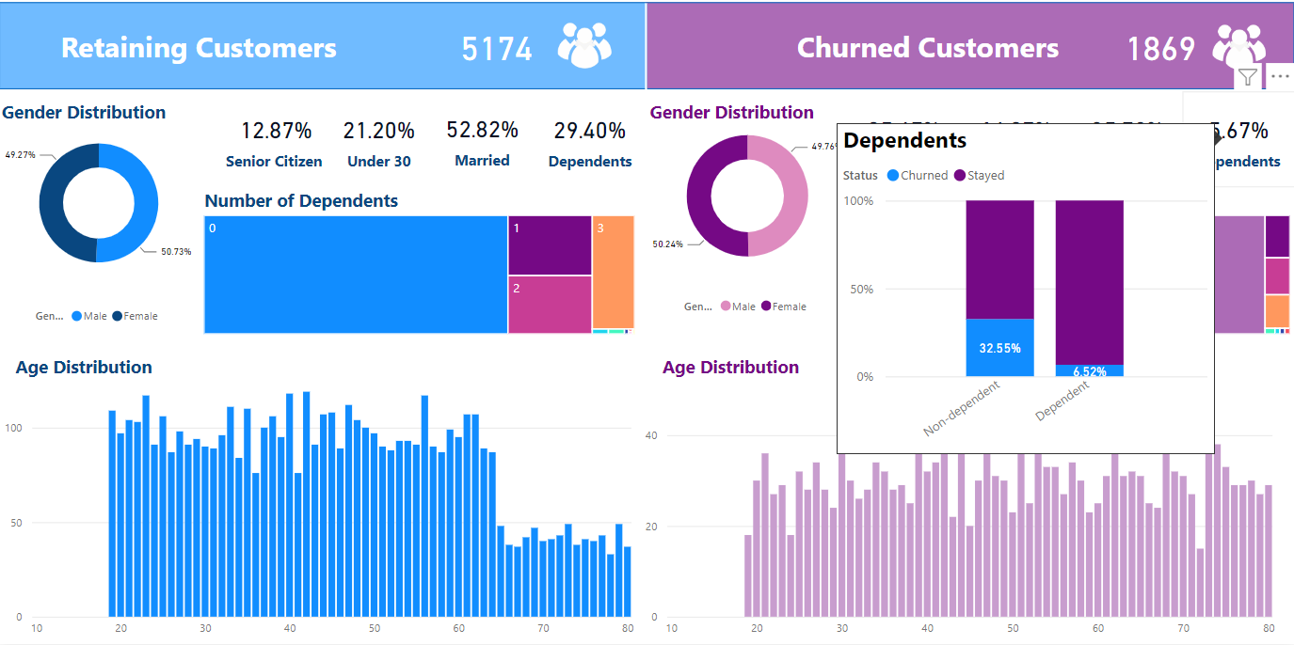
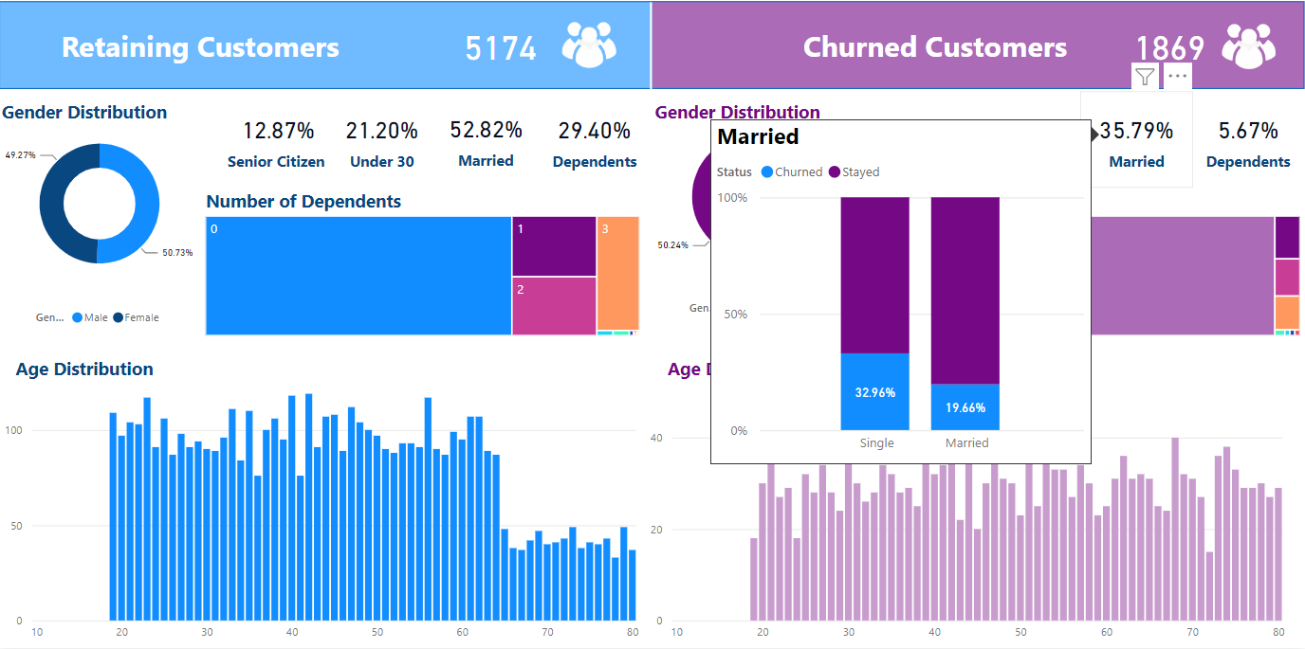
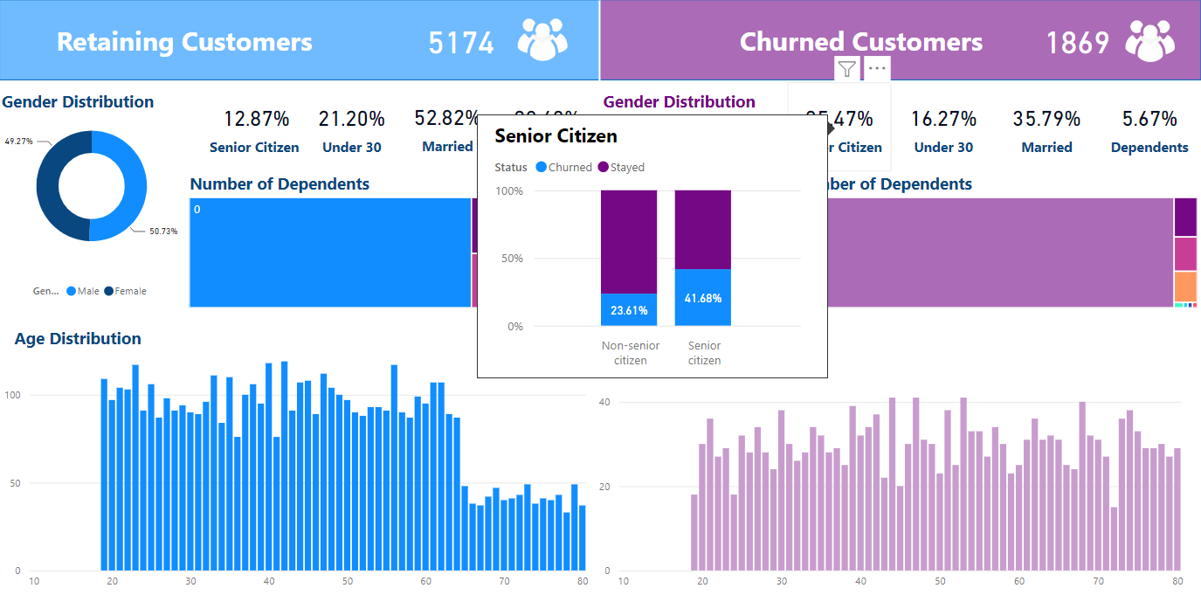
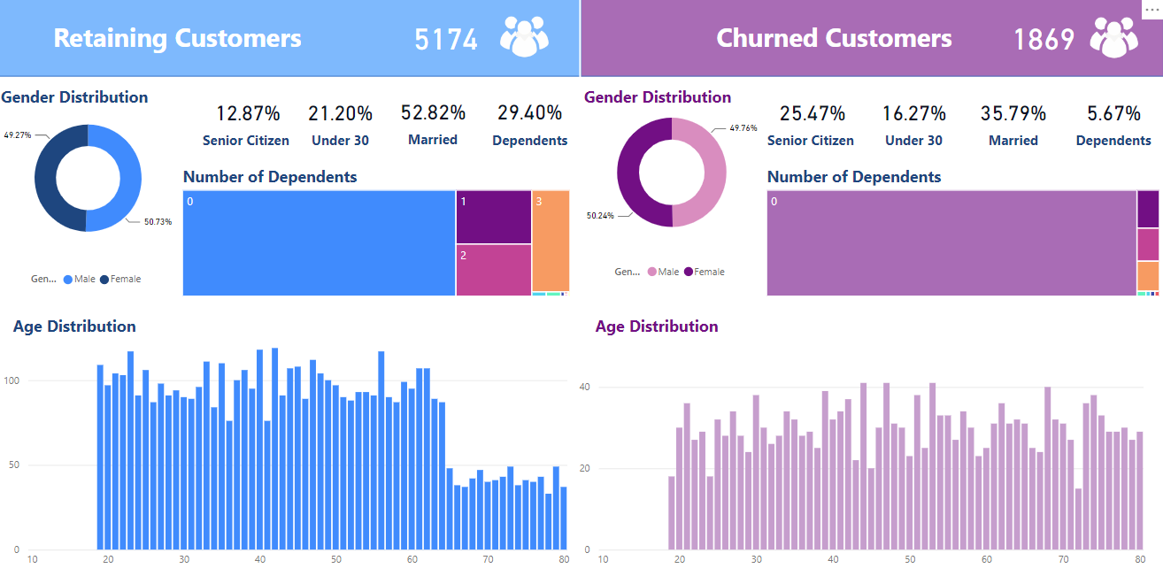
Customer Demographic

Slide 12
Customer Demographic
Gender is not a significant factor for churning
Senior citizens have a relatively high churn rate at 41%, which is almost twice as high as non-senior citizens.
Having dependents(e.g children) reduce the likelihood of churn. There is only 6% churn among customers that have dependents, about 5 times lower than customers that do not.
Customers that are single have 13% higher churn rate than married ones.

Slide 13
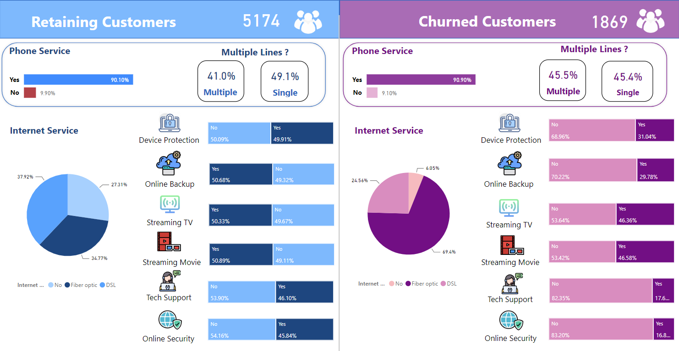
Customer Services

Slide 14
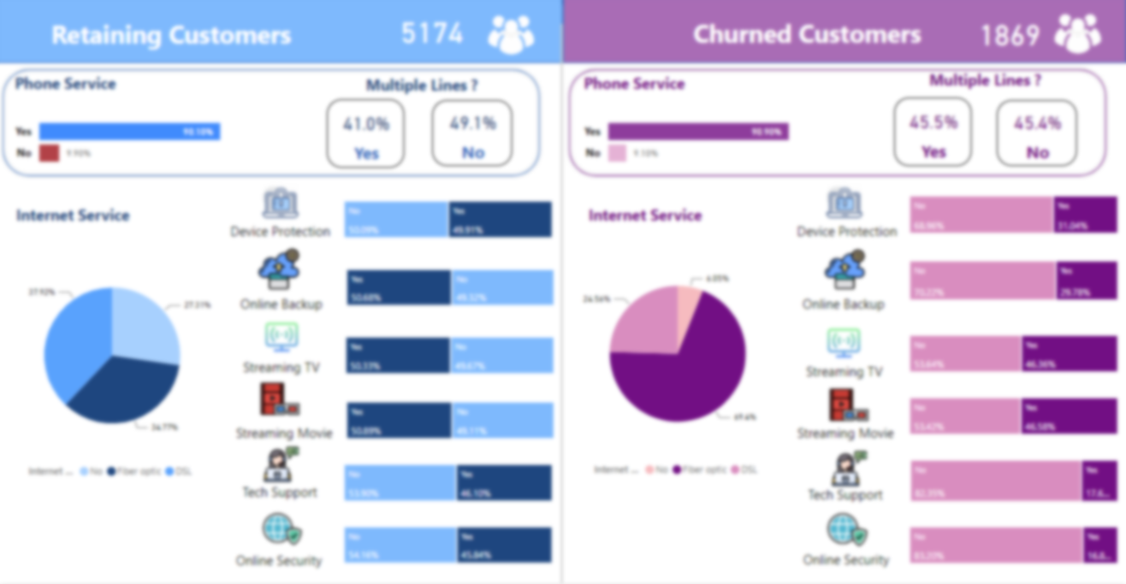
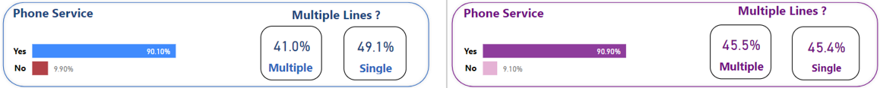
Customer Services

Slide 15

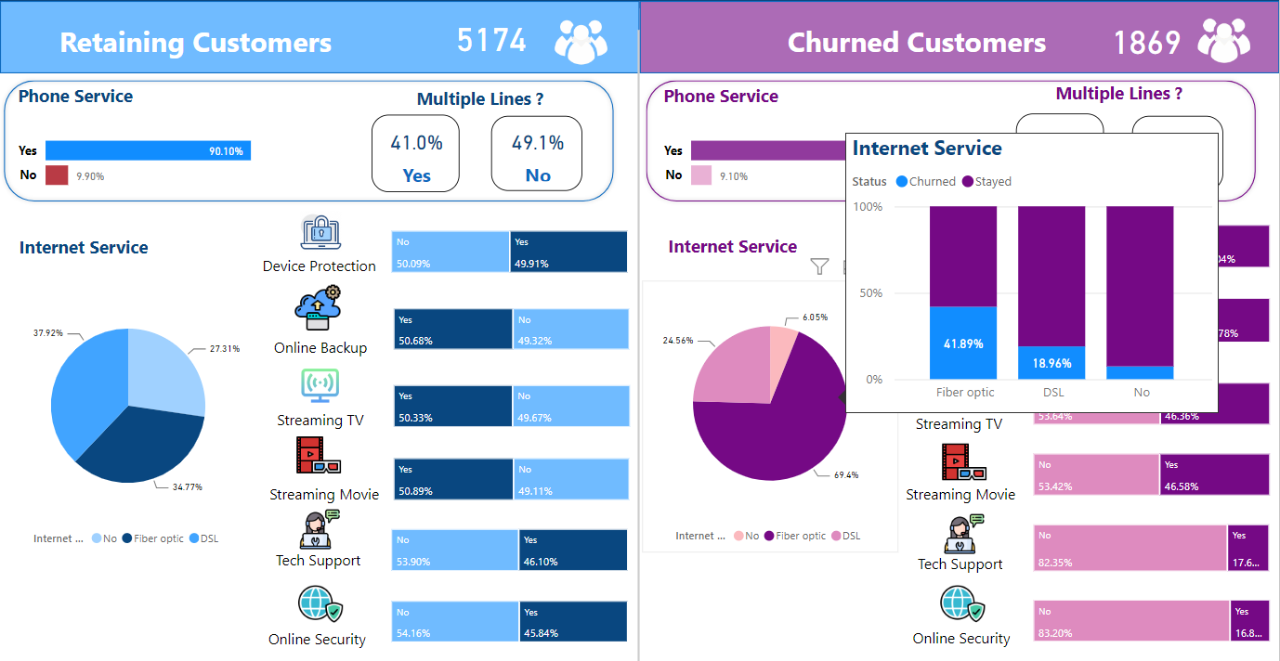
Customer Services

Slide 16
Customer Services

Slide 17
Customer Services
Phone service and Multiple lines are not two factors that greatly affect customer churn rate
Customer churn uses a lot of fiber optic services (69.4%), and this can be a factor leading to customer churn
High customer churn rates can also be seen among customers who do no use the tech support and online security services.

Slide 18
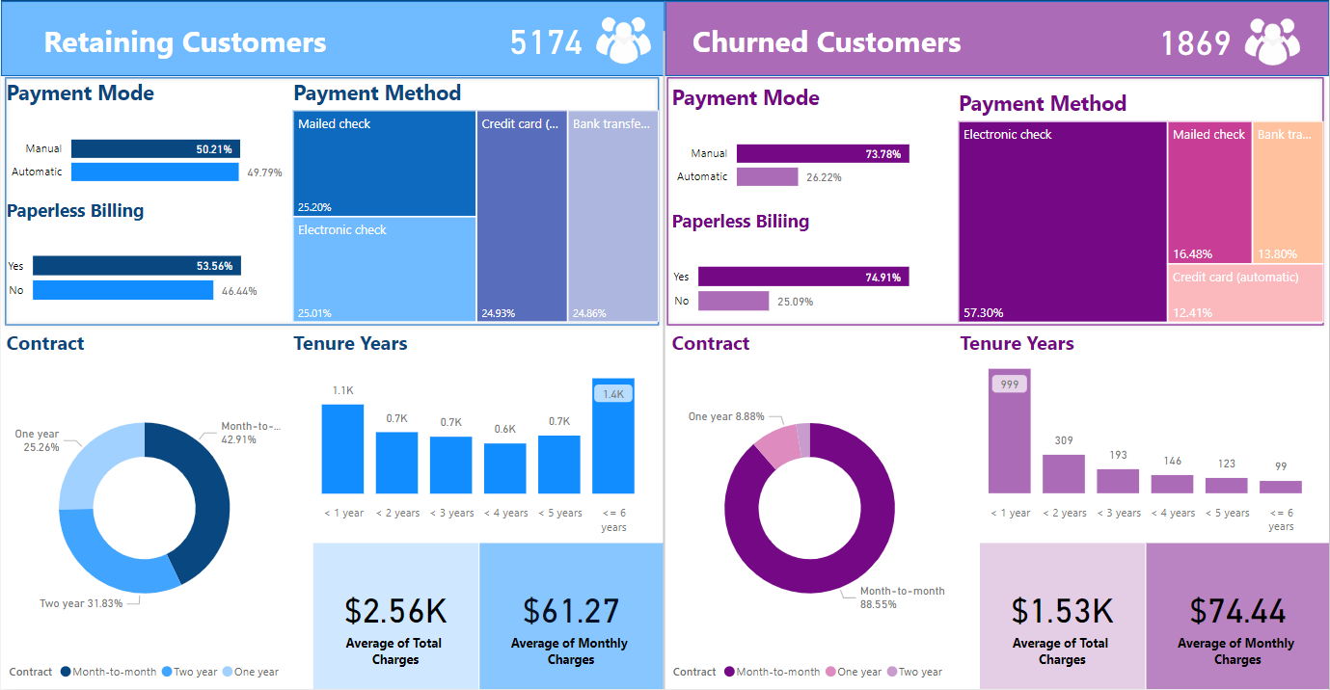
Account Information

Slide 19
Account Information
Most customers churn using manual payment mode (1379 customers)
• 57.3% churn customer using Electronic check payment method.
88.55% churned customer opting for month-to-month contract.
New customers (i.e., tenure under 12 months) have the highest cases of churn
Customers who have churned have a slightly higher monthly charges.

Slide 20
Top 6 potential churn factors
01
02
03
Senior citizen and non-dependent customer
Subcribed to Fiber optic service
not subscribing to online security service and tech support
04
05
06
Using Electronic checks and Paperless billing
New customer with tenure within the first 12 months
Customer with month-to-month contract

Slide 21
04
Proposed Solutions

Slide 22

Senior citizen and non-dependent customers
Enhanced Customer Support for Seniors
+ Provide specialized customer support for seniors. This may involve training customer support representatives to be patient, empathetic, and adept at addressing the concerns of senior customers.
Customized Plans for Non-dependent Customers and Seniors
+ Create plans specifically designed for non-dependent customers and seniors, offering flexibility and features that cater to their individual needs.
TARGET : Reduce the churn rate of senior citizen and non-dependent customer by 20%

Slide 23



Subcribed to Fiber optic Service
Enhanced Connectivity speed
+ Implement better technology to match the increasing need for higher connectivity speed of the customers.
Pricing
+ Research for competitors’ pricing, bundles and discounts to be more competitive and reduce churn
Online security and Tech Support
Bundled Service Packages
+ Create bundled packages that offer a combination of services at a discounted rate
Trial Periods
+ Introduce trial periods for online security and tech support services.
TARGET : 70% customer using Online security and tech support services

Slide 24

Using Electronic checks and Paperless billing
Incentives for Auto-Pay
+ Offer discounts or rewards for customers who enroll in auto-pay services using electronic checks
Enhance Billing Clarity
+ Ensure that billing statements for customers using electronic checks and paperless billing are clear and easy to understand.
TARGET : 70% customer using automatic payment mode

Slide 25



New customer with low tenure and opting for month-to-month contract
Exclusive Welcome Offers
Regular Check-ins and Feedback Sessions
Loyalty Rewards Program
Education on Long-Term Benefits
TARGET : Increase the number of people signing up for 1-year and 2-year contracts by 10%

Slide 26
Thanks!

